Slide 1
Quiz application
Using Python

Slide 2
Problem Details
The objective of this project is to set quizzes and allow users to take up the multiple-choice quiz using the command line.

Slide 3
Features:
Super-users should be able to set up the questions and correct answers for the question.
Super-users should be able to add the questions based on the topics and difficulty level.
The Quiz should support MCQ type questions with single correct options.
Users should be able to take up the quiz.

Slide 4
Features
The application should display the final score and the right answers.
When a user attempts a quiz, questions need to be fetched automatically from the one’s set by admin.
Test taker’s details and the result should be displayed on the screen.

Slide 5
App Design
Examiner or Admin
Questions
results
Candidate

Slide 6
Examiner or Admin powers
1. If the Superuser is Admin the questions will be automatically drawn from the question prompt
2. If the Super user is not Admin or some external examiner he can add the questions on difficulty level and give the quiz

Slide 7
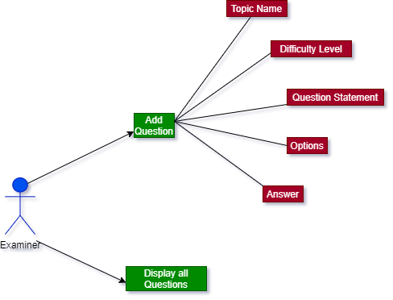
Examiner

Slide 8
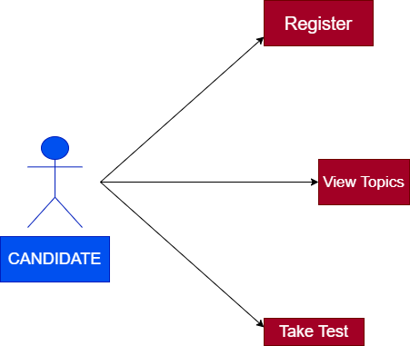
Candidate

